Slide 1


Applications of Information & Communication Technology CS181
Week 1
Fall-2023
Department of Computer Science

Slide 2
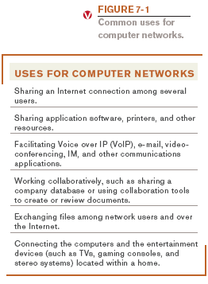
What Is a Network?
Network:
A connected system of objects or people
Computer network:
A collection of computers and other hardware devices connected together so users can share hardware, software, and data, and electronically communicate
Computer networks converging with telephone and other communications networks
2

Slide 3
Networking Applications
The Internet
Telephone service
Mobile phones (wireless phones)
Cellular (cell) phones - must be within range of cell tower to function
Satellite phones - used where cell service isn’t available
Dual-mode phones - allow users to make telephone calls on more than one network
Cellular / Wi-Fi dual-mode phones are most popular
3

Slide 4
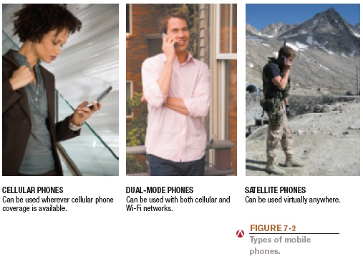
Mobile Phones
4

Slide 5
Networking Applications
Television and radio broadcasting
Global positioning system (GPS): Uses satellites and a receiver to determine the exact geographic location of the receiver
Commonly used by individuals to determine their exact location
Used on the job by surveyors, farmers, and fishermen
Used to guide vehicles and equipment
Used by the military to guide munitions
5

Slide 6
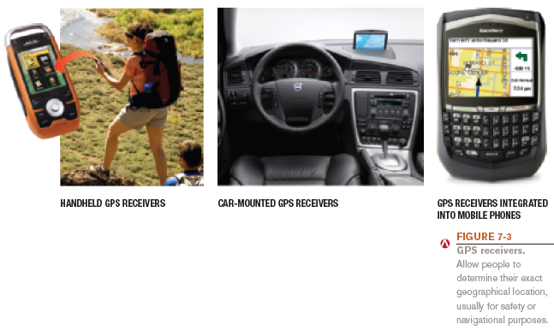
GPS
6

Slide 7
Networking Applications
Monitoring systems: Monitor status or location of individuals, vehicles, assets, etc.
RFID-based systems
Monitor the status of objects
GPS-based monitoring systems
Monitor the physical location of objects
Electronic medical monitors and other types of home health monitoring
Sensor networks
7

Slide 8
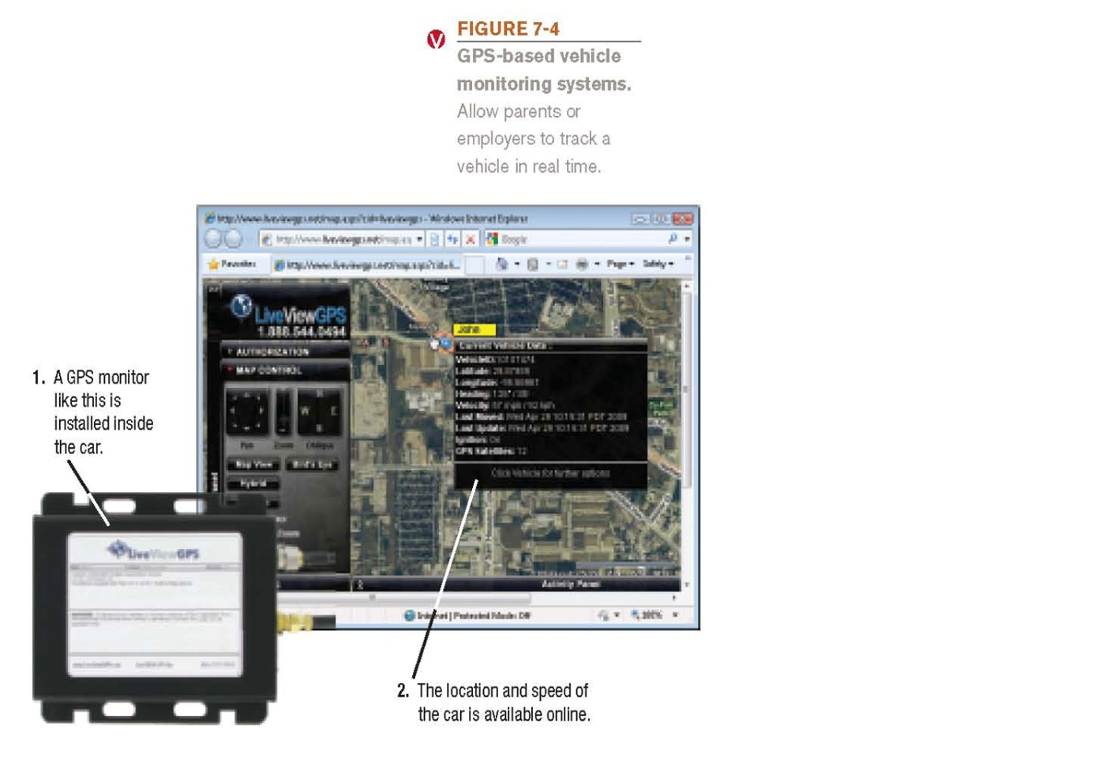
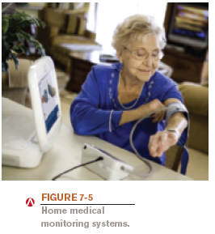
Monitoring Systems
8

Slide 9
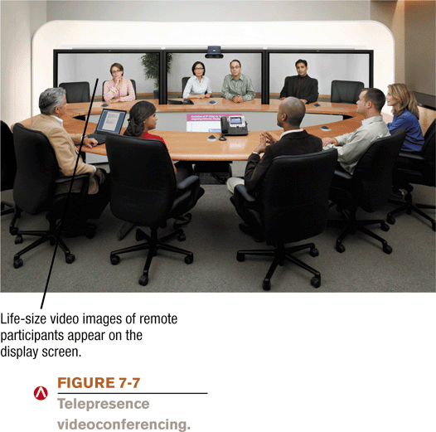
Networking Applications
Videoconferencing: Use of computers, video cameras, microphones, and networking technologies to conduct face to face meetings over a network.
Online conferencing (via the Internet)
Telepresence videoconferencing
Collaborative computing (workgroup computing)
Telecommuting
9

Slide 10
What is Network Topology?
In networking the term “topology” refers to the layout of connecting devices on the network.
A computer network is a collection of two or more computers which are connected together to share information and resources.

Slide 11
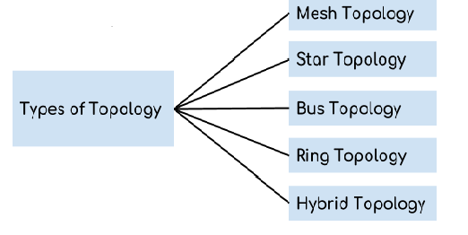
Types of Topology
Types of topology based on architecture:

Slide 12
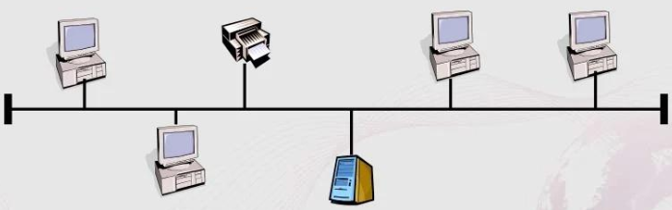
Bus topology
A bus topology consists of a single cable - Called a bus-
Connecting all nodes on a network without intervening connecting devices.

Slide 13
Pros & Cons of Bus topology
Pros:
Works well for small networks.
Easy to expand joining two cables together.
Relatively inexpensive to implement.
Cons:
Management costs can be high.
Cables fails then whole network fails.

Slide 14
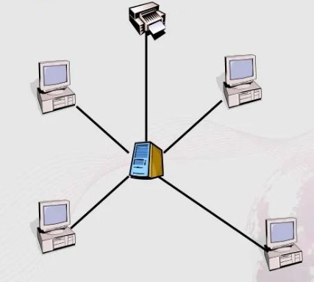
Star Topology
A star network is designed with each node (file server,workstation) connected directly to a central network hub or server.

Slide 15
Pros & Cons of Star topology
Pros:
Easy to manage.
Low startup costs.
Offers opportunities for expansion.
Cons:
Hub is a single point of failure.
Requires more cable than the bus.

Slide 16
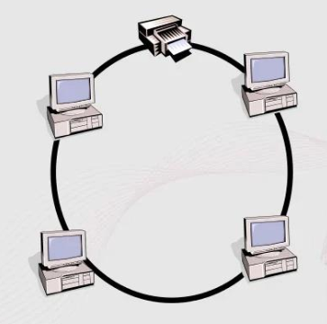
Ring Topology
A ring topology is one where all workstations and other devices are connected in a continuous loop. There is no central server.

Slide 17
Pros & Cons of Ring topology
Pros:
Easier to locate a defective node or cable problem.
Handles high-volume network traffic.
Cons:
Expensive
Requires more cable and network equipment at the start.

Slide 18
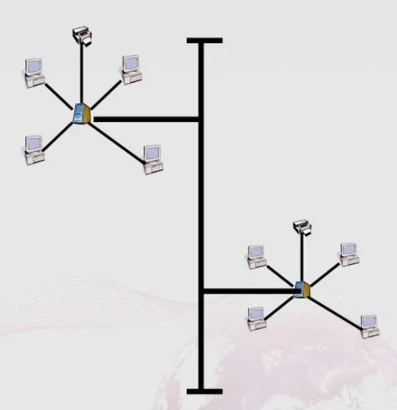
Tree Topology
It has a root node and all other nodes are connected to it forming a hierarchy.It is also called Hierarchical topology.

Slide 19
Pros & Cons of Tree topology
Pros:
Extension of bus and star topology.
Easily managed and maintained.
Cons:
Heavily cabled.
Costly.
If more nodes are added maintenance is difficult.

Slide 20
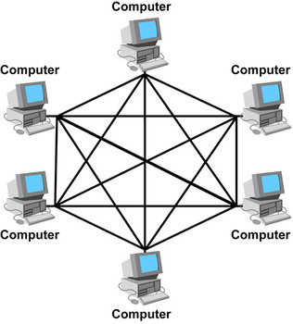
Mesh Topology
It is a point to point connection to other nodes or devices. Traffic is carried only between two devices or nodes to which it is connected.

Slide 21
Pros & Cons of Mesh topology
Pros:
Each connection can carry its own data load.
Fault is diagnosed easily.
Cons:
Installation and configuration is difficult.
Cabling cost is more.

Slide 22
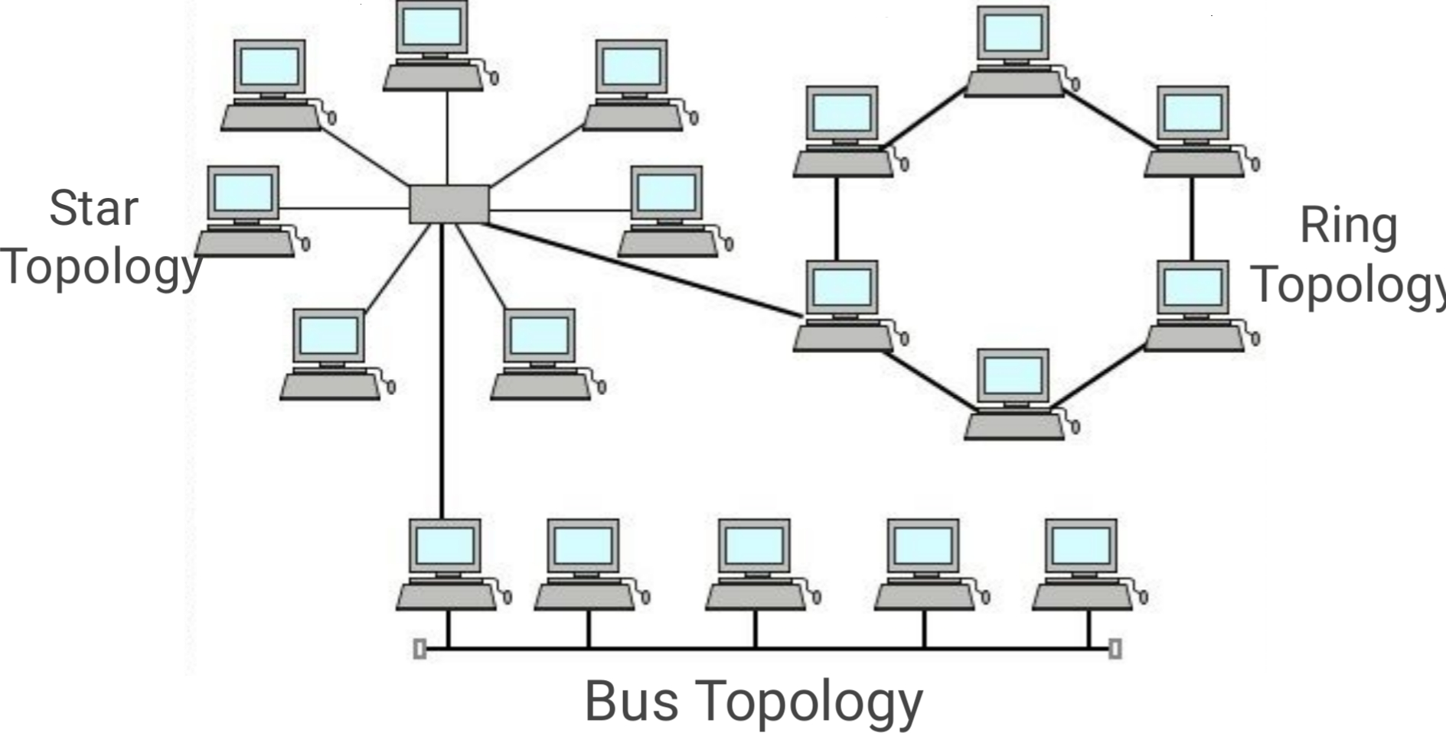
Hybrid Topology
It is a mixture of two or more topologies.Therefore it is called hybrid topology.Hybrid topology combines characteristics of linear bus, star and ring topologies.

Slide 23
Pros & Cons of Hybrid Topology
Pros:
Scalable as error detecting and trouble shooting is easy.
Effective
Cons:
Complex in design.
Costly.

Slide 24
Network Architectures
The way networks are designed to communicate
There are two types of Network Architectures:
Client-server network architecture
Peer to Peer network architecture
24

Slide 25
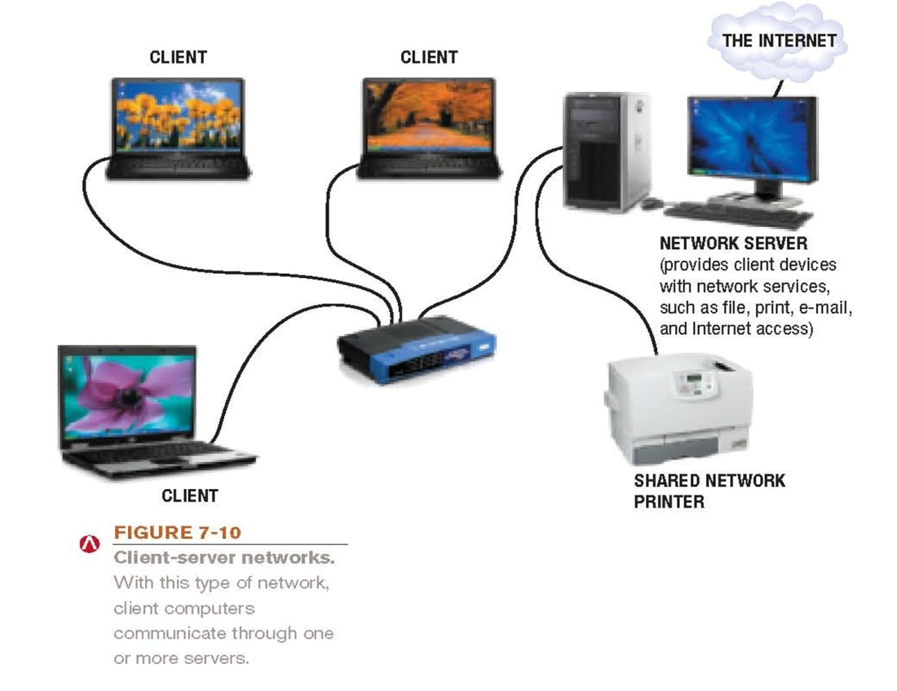
Client-server network architecture
Client: Computer or other device on the network that requests and utilizes network resources
Server: Computer dedicated to processing client requests

Slide 26
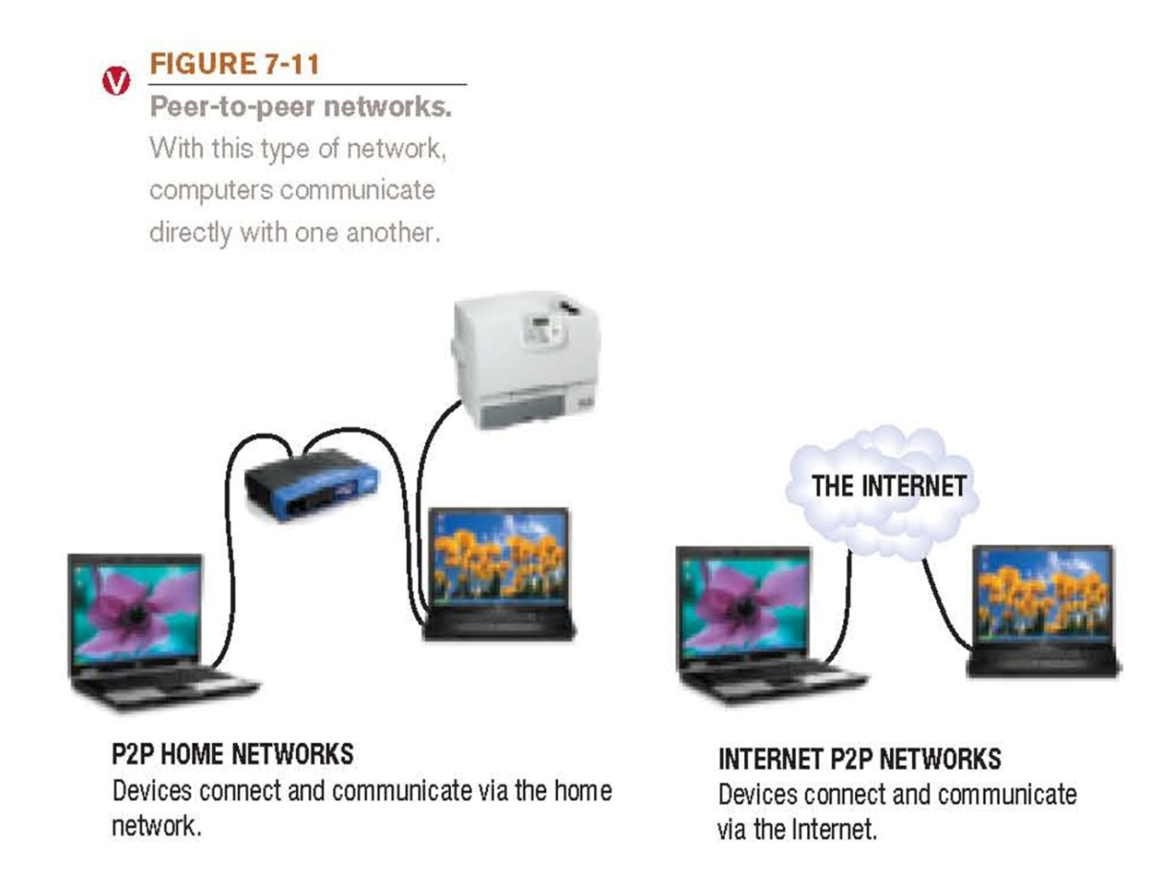
Peer to Peer network architecture
All computers at the same level
Torrent / Shareit / Zapya
Internet P2P computing: Performed via the Internet
26

Slide 27
Client server vs Peer to Peer
Client Server | Peer to peer
Client-Server Network focuses on information sharing. | While Peer-to-Peer Network focuses on connectivity.
Client-Server Network are more stable than Peer-to-Peer Network | While Peer-to-Peer Network are less stable if number of peer is increase.
Doesn’t require extensive hardware to set up the network. | Expensive to implement
27

Slide 28
Types of Network
Broadly network can be classified into four types depending on the scalability of the network.
LAN
MAN
WAN
PAN

Slide 29
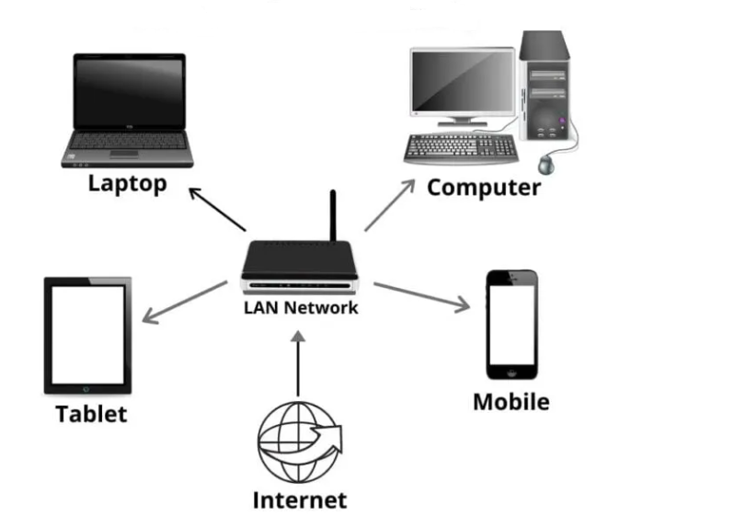
LAN
LAN stands for Local area network.it covers the small area as name suggests,a local area.
This usually include a local office and they are also pretty common in homes now.
A local area network is a group of computers and associated devices that share a common communication line.

Slide 30
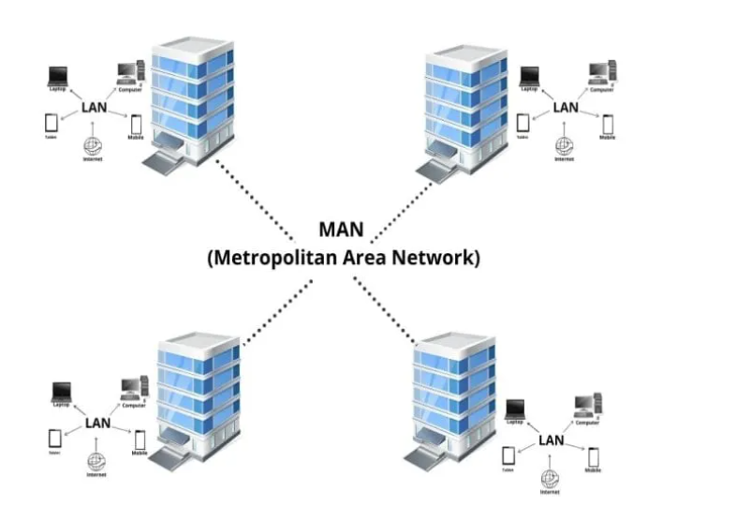
MAN
MAN stands for Metropolitan Area Network.
A MAN is a computer network that interconnects users with computer resources in a geographic area or region
larger than that covered even a large LAN
but smaller than the area covered by a WAN.

Slide 31
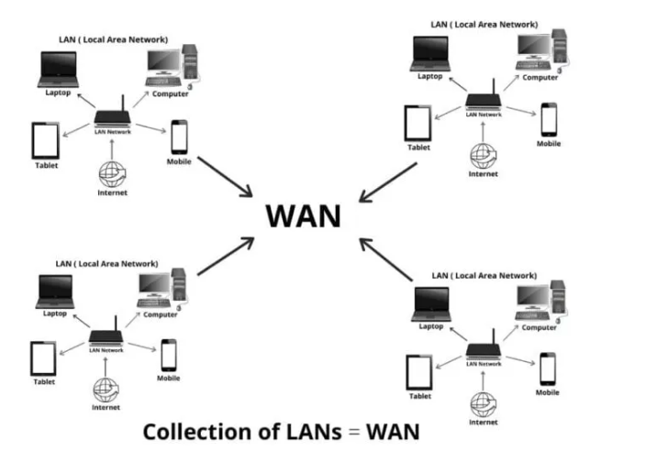
WAN
WAN stands for wide area network.
A WAN is a telecommunications network or computer network that extends over a large geographical distance/place.

Slide 32
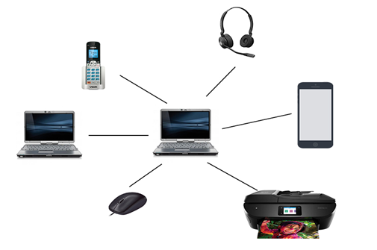
PAN
PAN stands for personal area network.
A PAN refers to the interconnection of information technology devices or gadgets within the environment of individual user.
These interconnected devices might include laptop computers,PDA,printers,pc or other wireable devices.

Slide 33
Network Size and Coverage Area
Intranet: Private network set up by an organization for use by its employees
Extranet: Intranet that is at least partially accessible to authorized outsiders
Virtual private network (VPN): Secure path over the Internet that provides authorized users a secure means of accessing a private network via the Internet
33

Slide 34
Data Transmission Characteristics
Transmission directions:
Simplex transmission
Data travels in a single direction only
Half-duplex transmission
Data travels in either direction but only one way at a time
Full-duplex transmission
Data travels in both directions, both ways at the same time
34

Slide 35
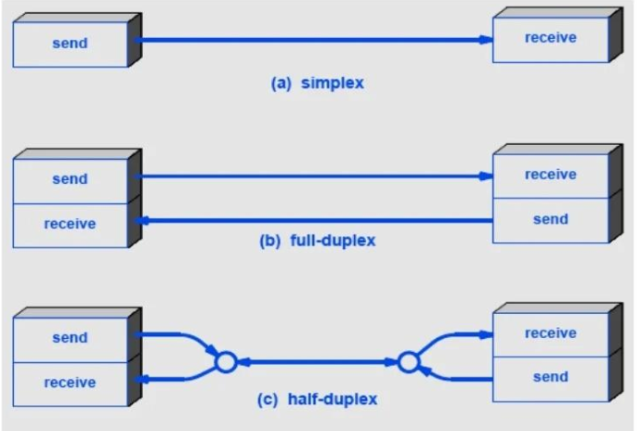
Transmission directions

Slide 36
Data Transmission Characteristics
Type of connections:
Circuit-switched:
Dedicated path over a network is established and all data follows that path
Packet-switched:
Messages are separated into small units called packets and travel along the network separately
Used to send data over the Internet
Broadcast:
Data is sent out to all other nodes on the network
Primarily used with LANs
36

Slide 37
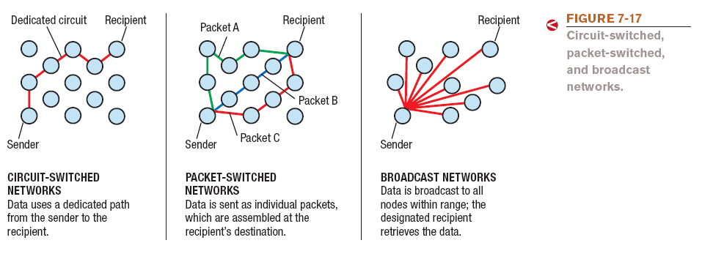
Type of Connections
37

Slide 38
Networking Media: Wired connections
The computer is physically cabled to the network
Twisted-pair cable
Pairs of wires twisted together
Used for telephone and network connections
Coaxial cable
Thick center wire
Used for computer networks, short-run telephone transmissions, cable television delivery
Fiber-optic cable
Glass or fiber strands through which light can pass
Used for high-speed communications
38

Slide 39
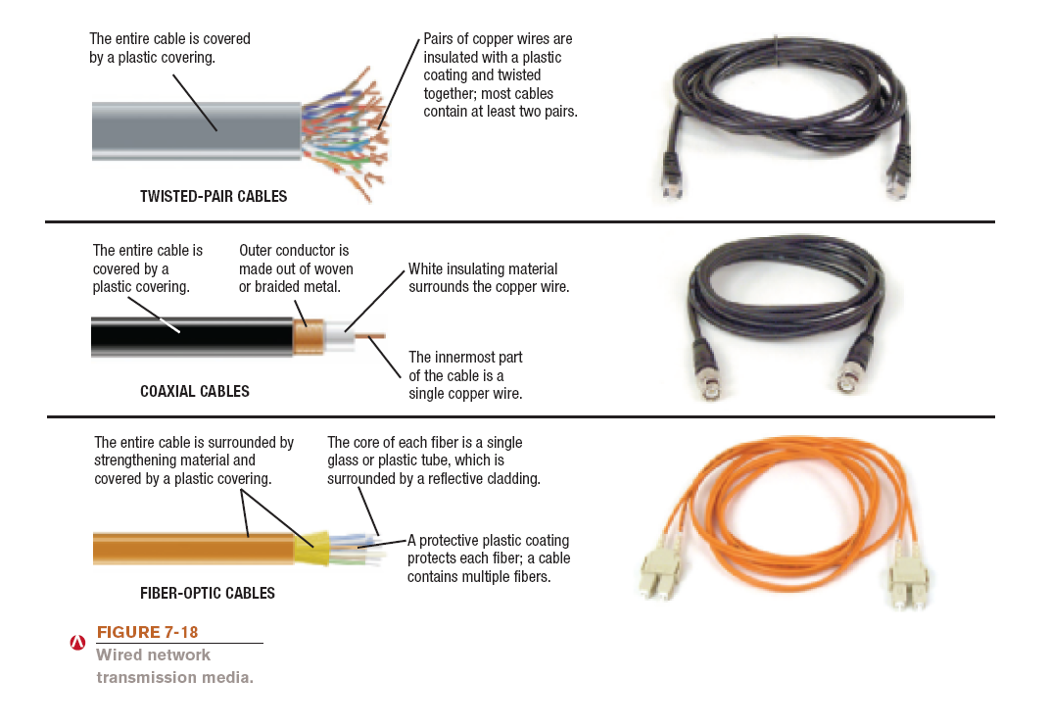
Wired Networking Media
39

Slide 40
Networking Media: Wireless connections
Wireless connections: Use radio signals
The electromagnetic spectrum is the range of common electromagnetic radiation (energy) that travels in waves
Short-range (such as Bluetooth) can connect a wireless keyboard or mouse to a computer
Medium-range (such as Wi-Fi) are used for wireless LANs and to connect portable computer users to the Internet at public hotspots
Longer-range (WiMAX) can be used to provide Internet access to wide geographic areas
Radio frequencies are assigned by the FCC and are measured in hertz (Hz)

Slide 41
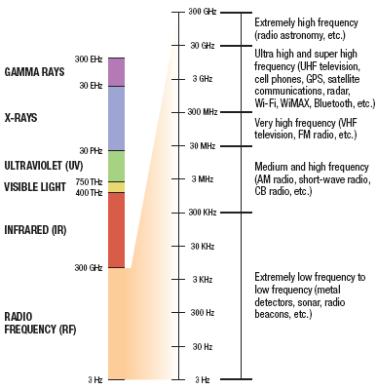
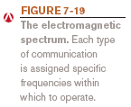
The Electromagnetic Spectrum

Slide 42
Networking Hardware
Networking hardware
Network adapter: Used to connect a computer to a network or the Internet
Also called network interface card (NIC) when in the form of an expansion card
Available in a variety of formats
PCI and PCIe
USB
ExpressCard
Adapter must match the type of network being used (Ethernet, Wi-Fi, Bluetooth, etc.)
42

Slide 43
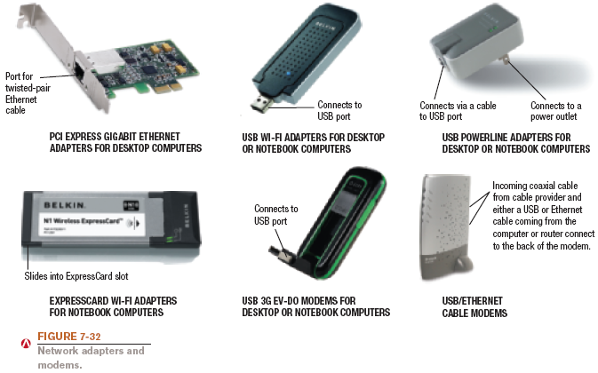
Network Adapters
43

Slide 44
Networking Devices
Networking devices are components used to connect computers or other electronic devices together so that they can share files or resources like printers or fax machines.
Following are some networking devices:
Hub
Switch
Gateway
Router
Repeater

Slide 45
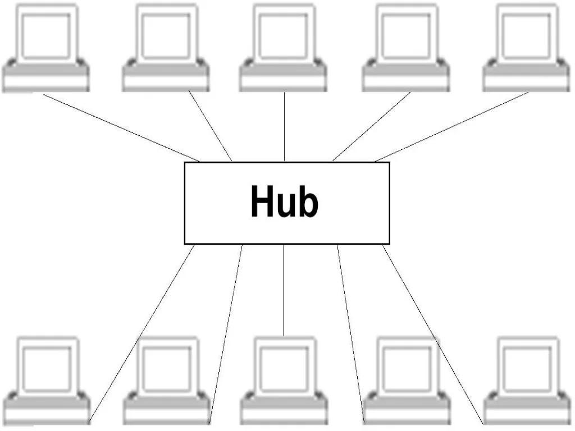
HUB
A repeater operates at the physical layer.
Its job is to regenerate the signal over the same network before the signal becomes too weak or corrupted so as to extend the length to which the signal can be transmitted over the same network.

Slide 46
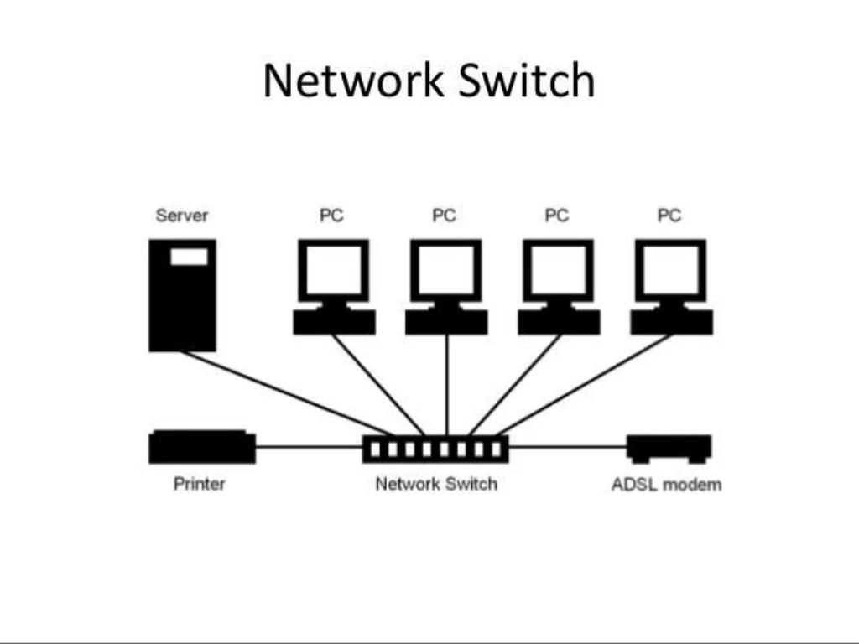
Switch
A switch is a multiport bridge with a buffer and a design that can boost its efficiency(a large number of ports imply less traffic) and performance. A switch is a data link layer device.

Slide 47
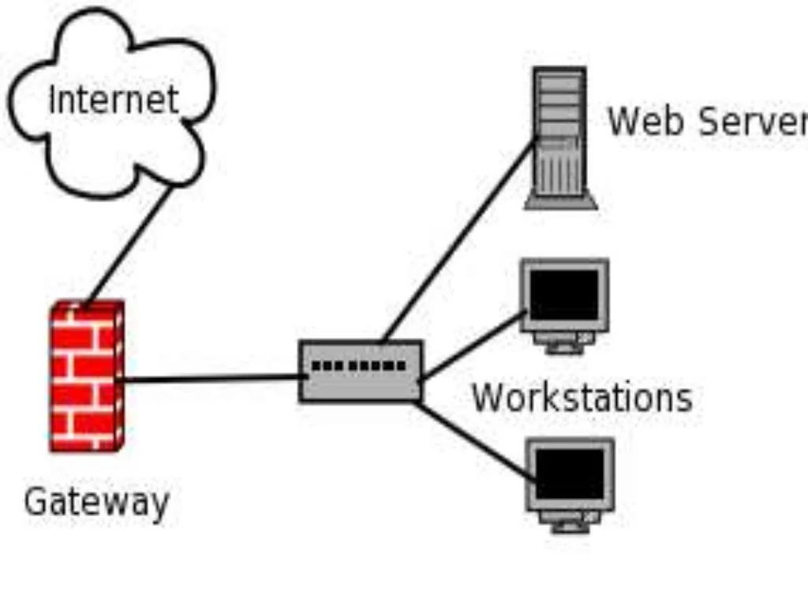
Gateway
A gateway, as the name suggests, is a passage to connect two networks together that may work upon different networking models.

Slide 48
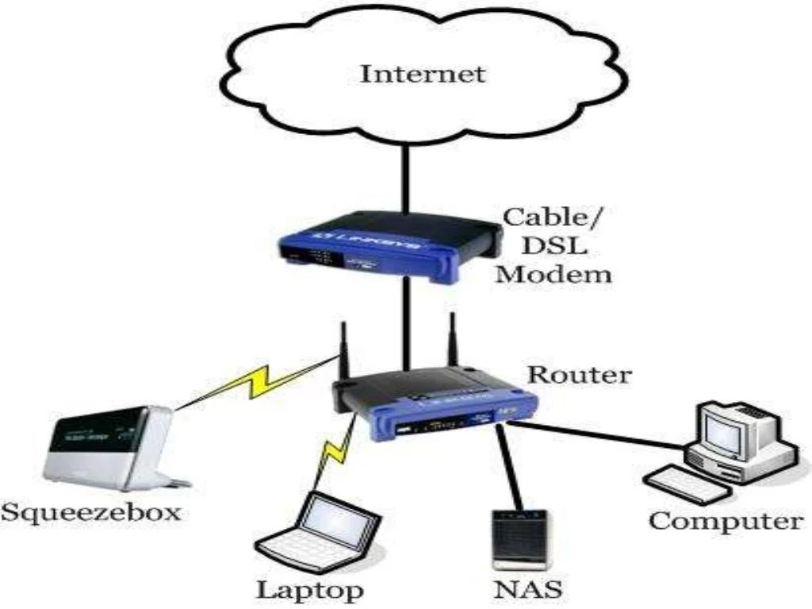
Router
A router is a device like a switch that routes data packets based on their IP addresses. The router is mainly a Network Layer device.

Slide 49
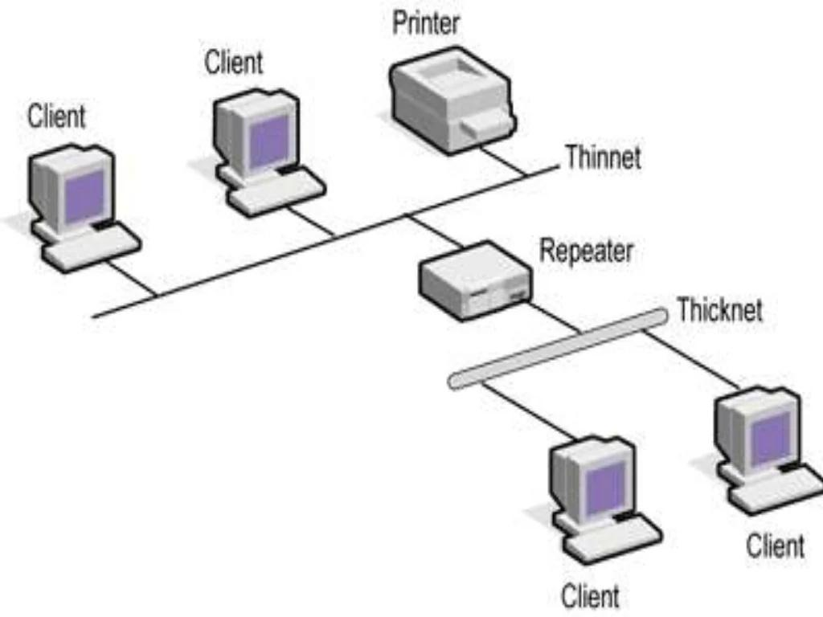
Repeater
A repeater operates at the physical layer.
Its job is to regenerate the signal over the same network before the signal becomes too weak or corrupted so as to extend the length to which the signal can be transmitted over the same network.

Slide 50
Any Question?

